Slide 1
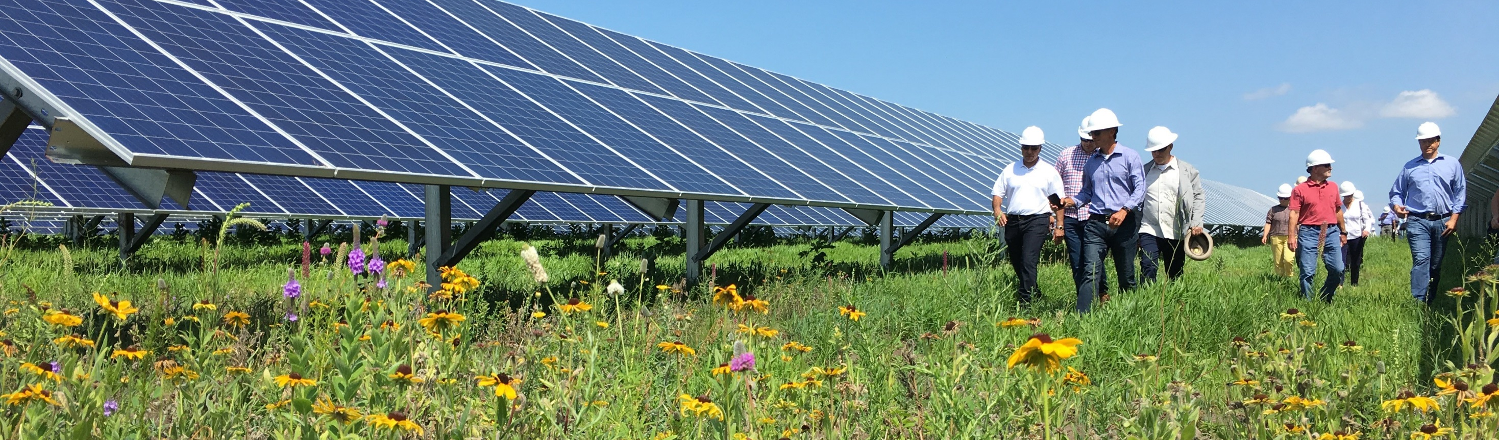
Working Together to Meet MN’s Clean Energy Goals
Steve Kelley | Commissioner
MN Department of Commerce

Slide 2
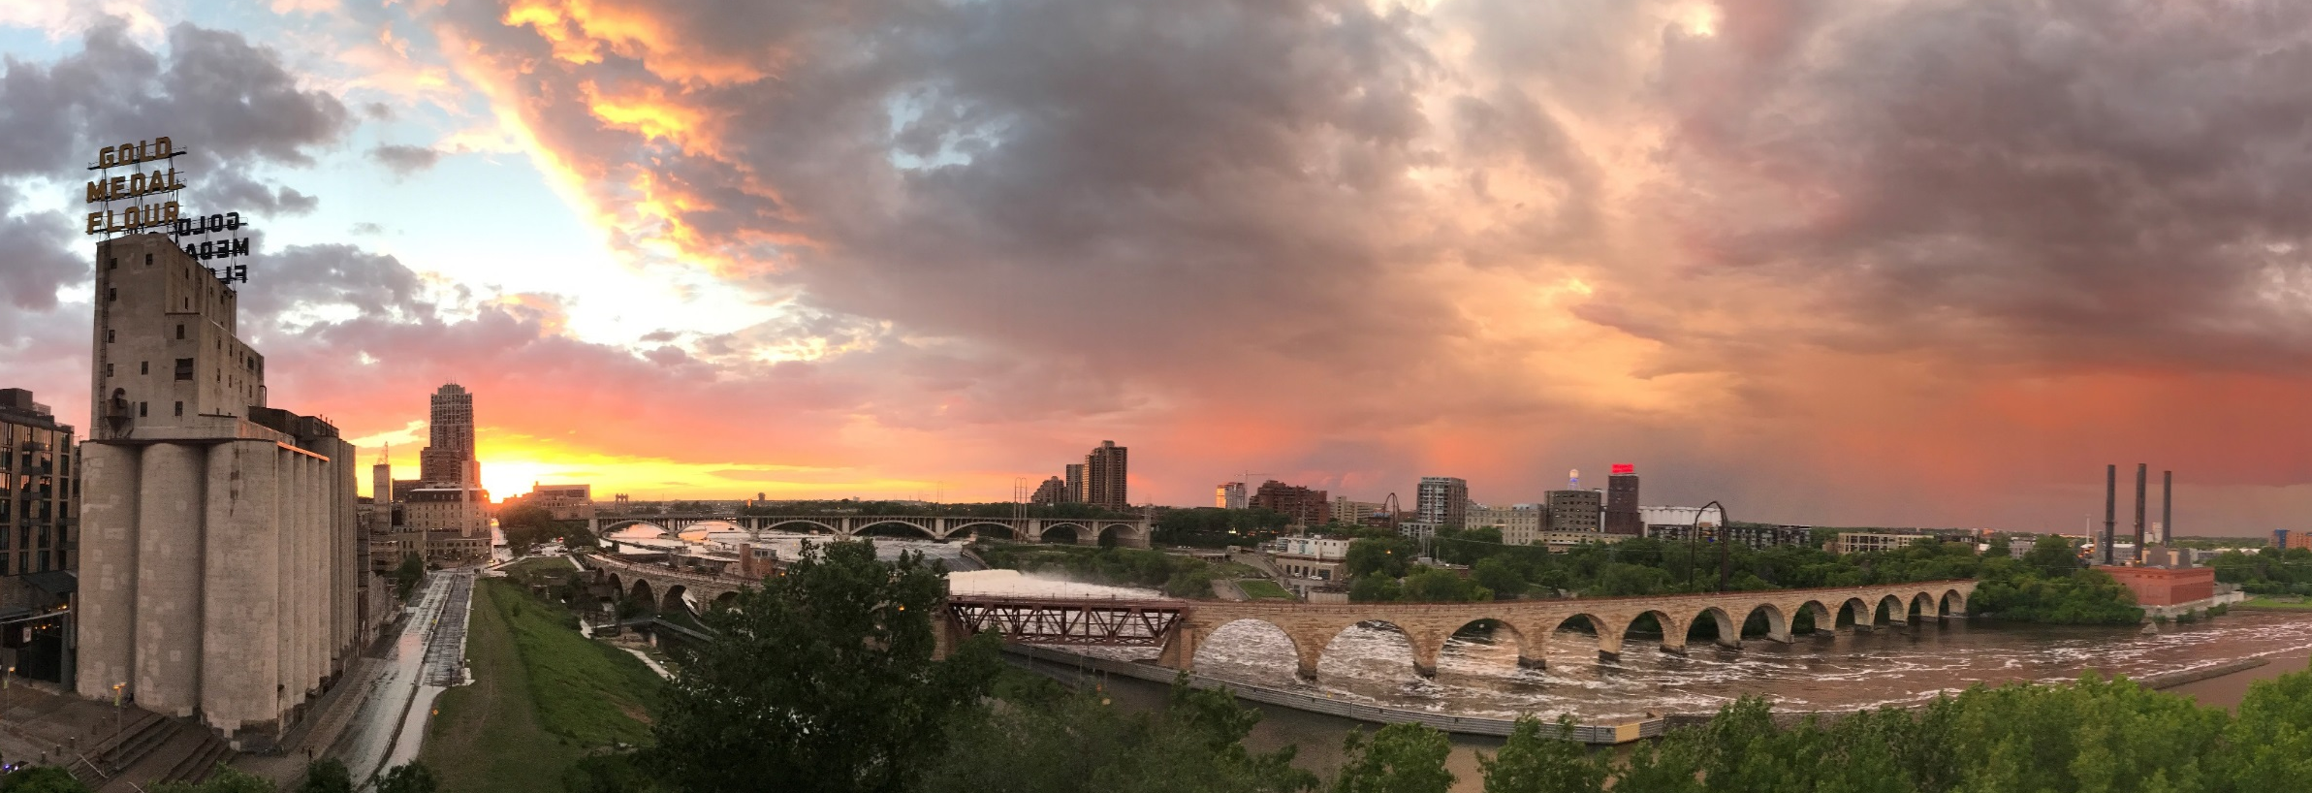
The Transformation to Date

Slide 3
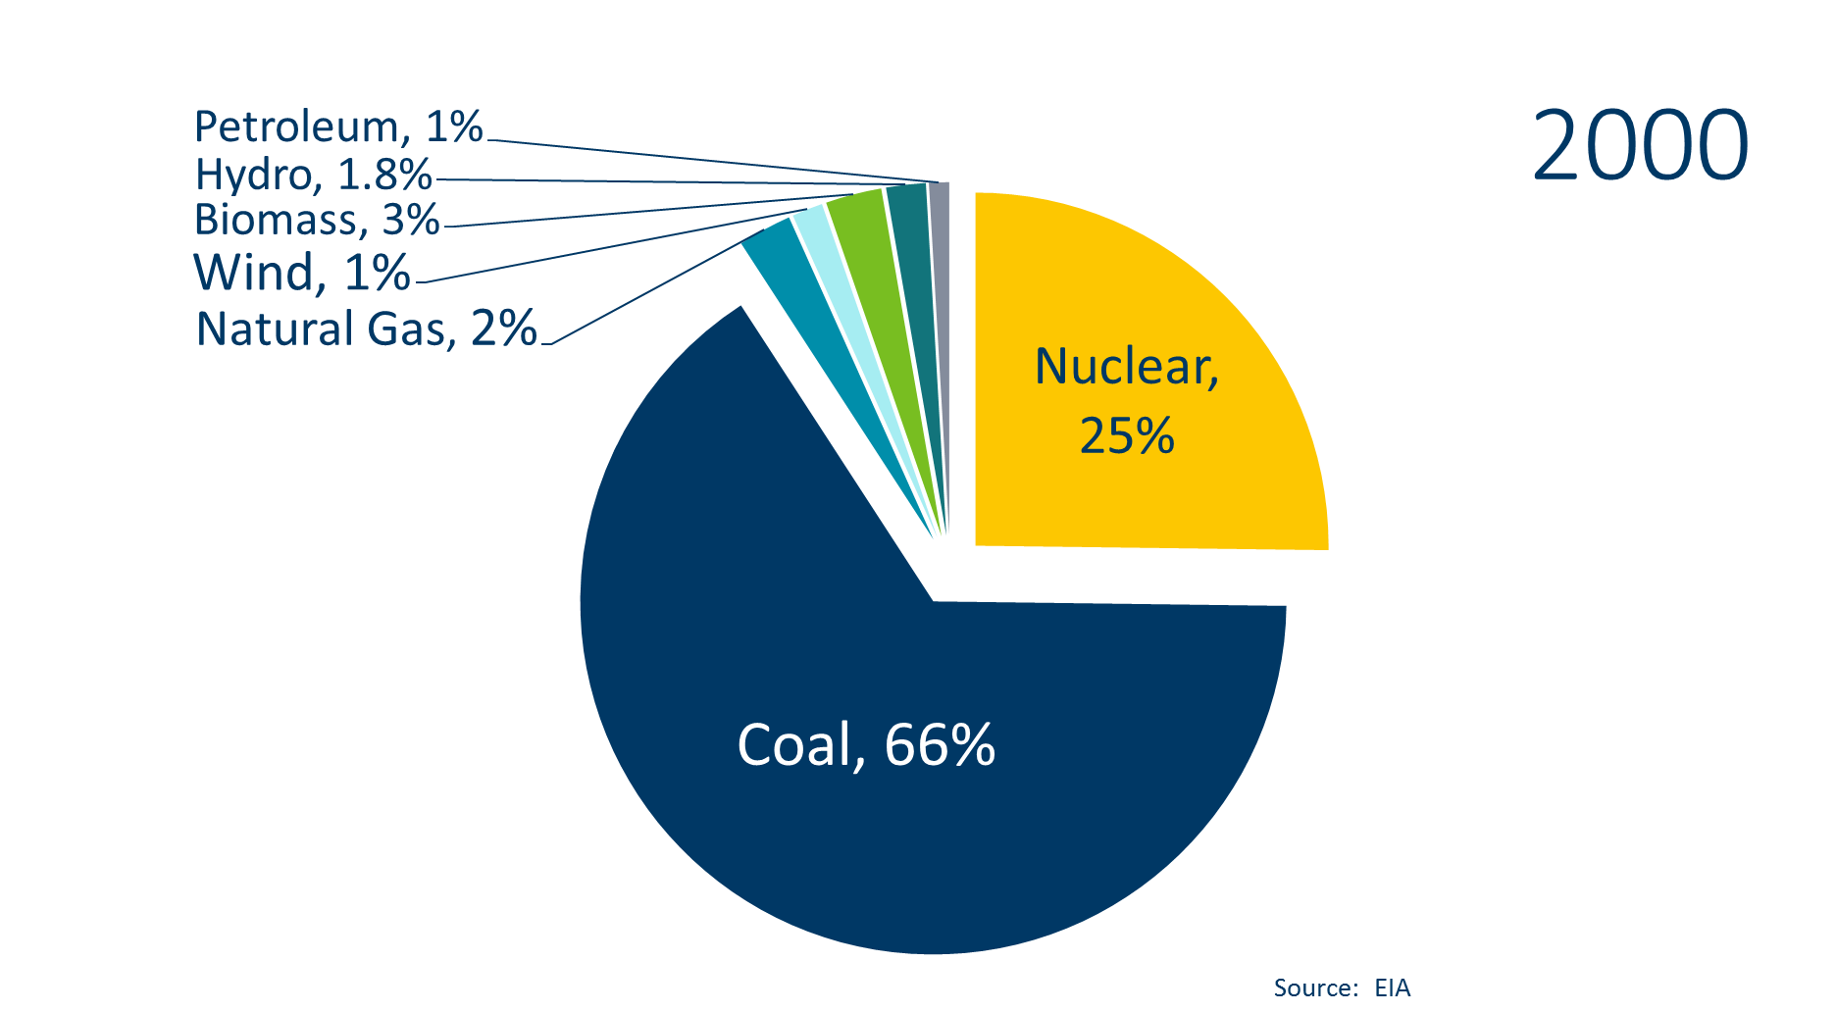
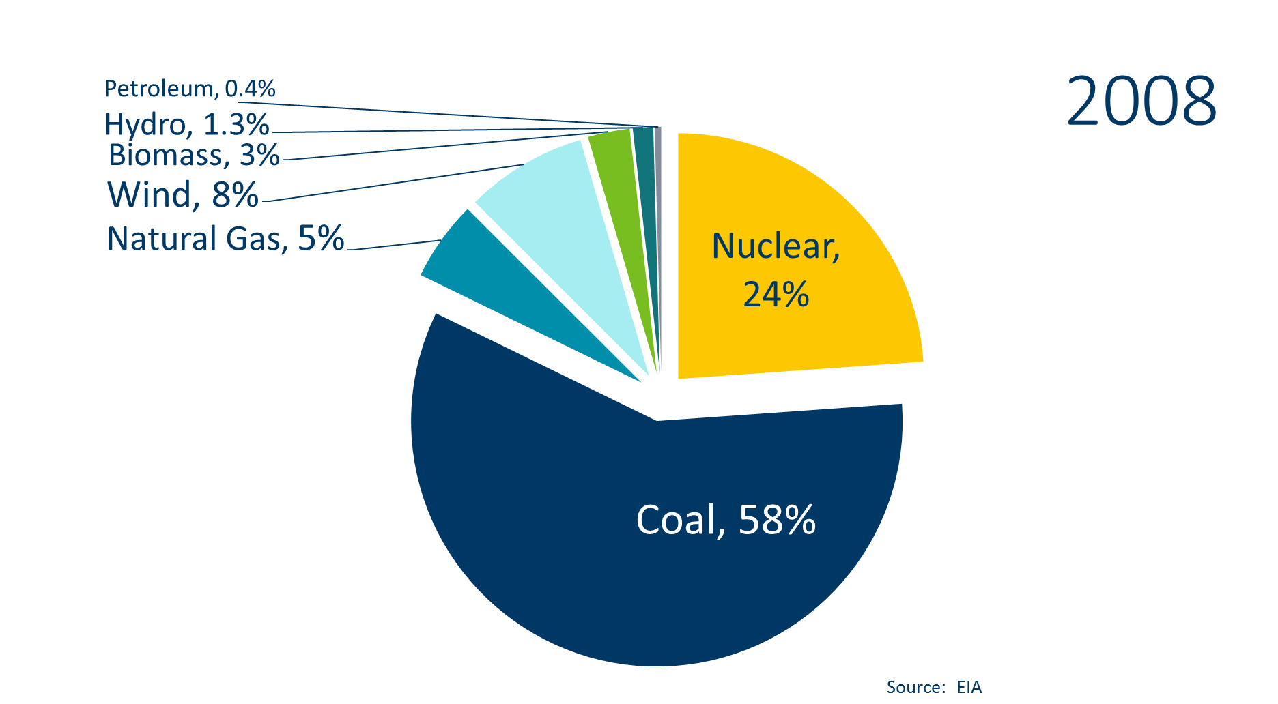
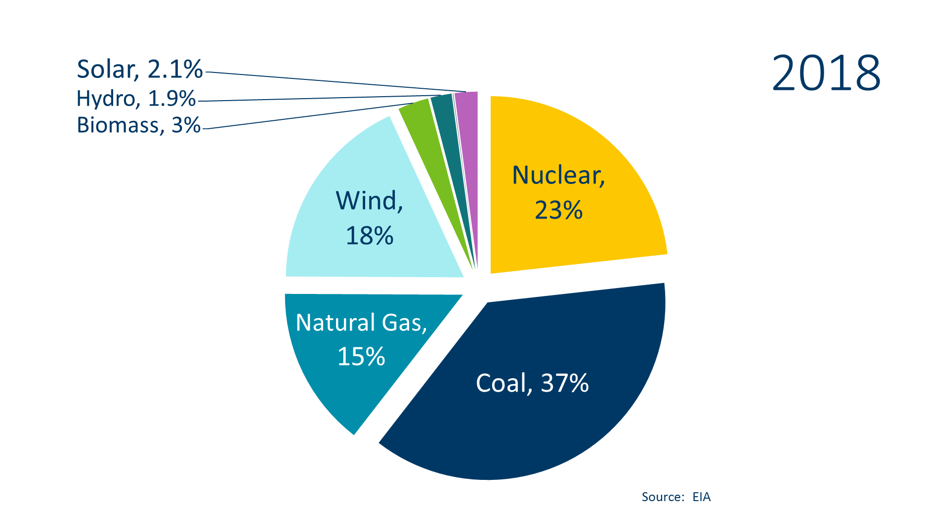
Electricity Generated in Minnesota

Slide 4
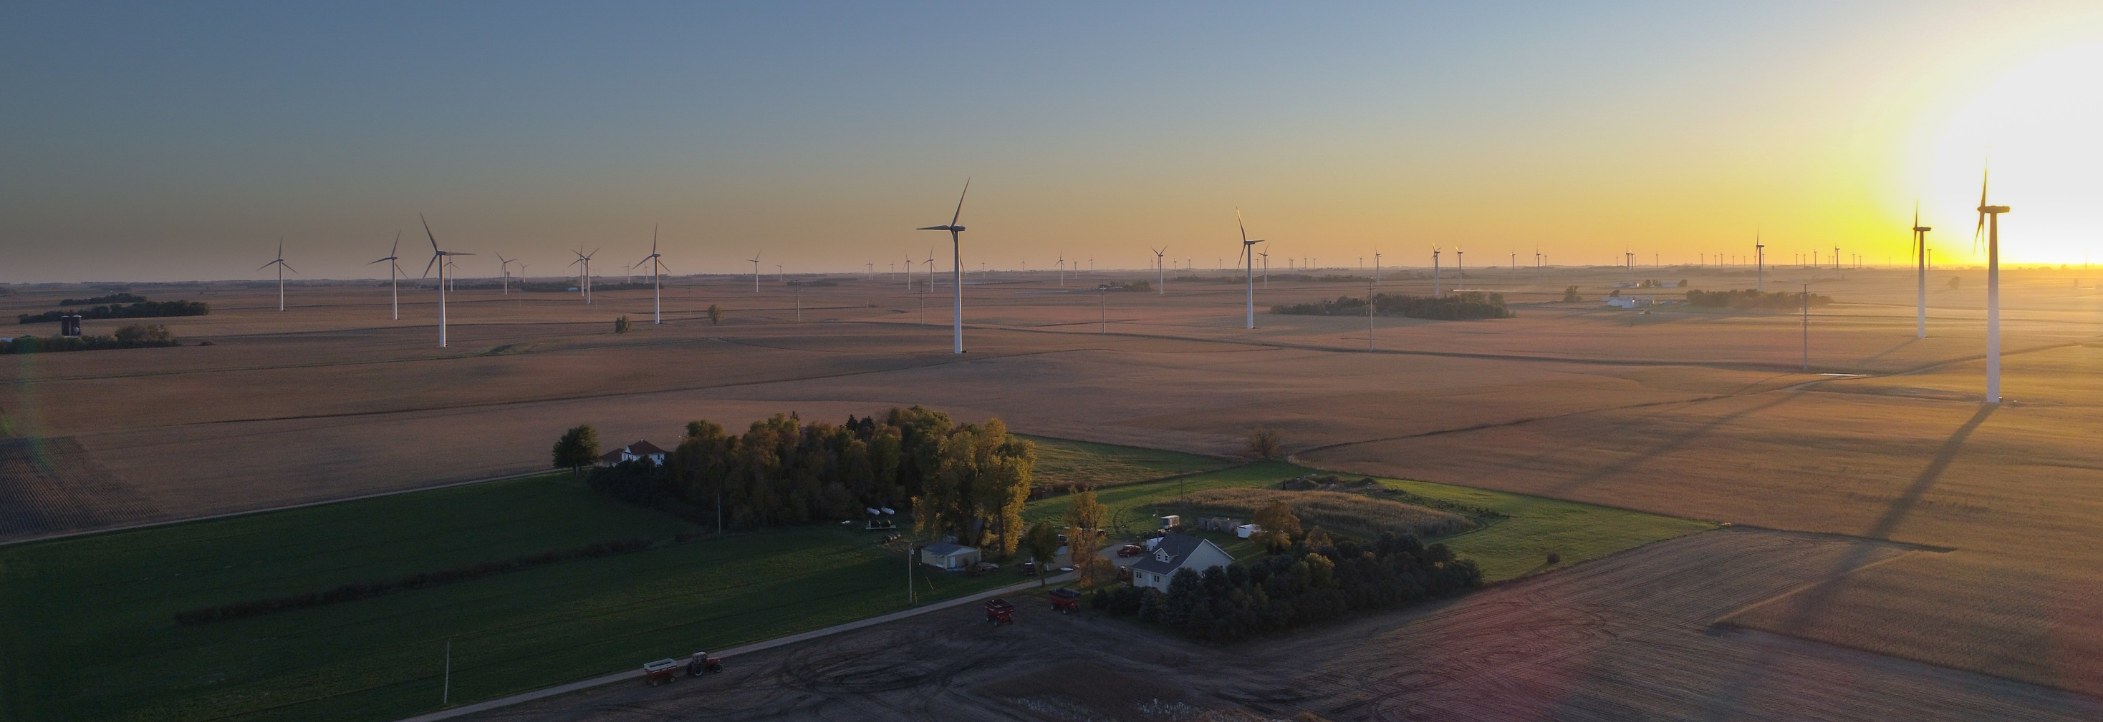
Clean Energy First

Slide 5
The Walz/Flanagan
Path to Clean Energy
100% Carbon-Free
by 2050
Requires all power sector resources to be carbon free by 2050
Resource agnostic but must be carbon free
Allows for utility electrification through efficient fuel switching programs
Energy Optimization
Updates MN Statute 216B.241
Updates the Conservation Improvement Program
Utility Energy Efficiency and Conservation Goals
1.75% = Investor Owned Electric Utilities
1.5% = Munis and Coops
1% = Natural Gas
Clean Energy First
Requires transmission planning studies to accommodate new renewables and resources
Regulatory Mechanism
Requires utilities to build clean energy when building new power plants or replacing retired facilities

Slide 6
In the next twenty years, 70% of MN’s current electric generation is eligible to be replaced

Slide 7
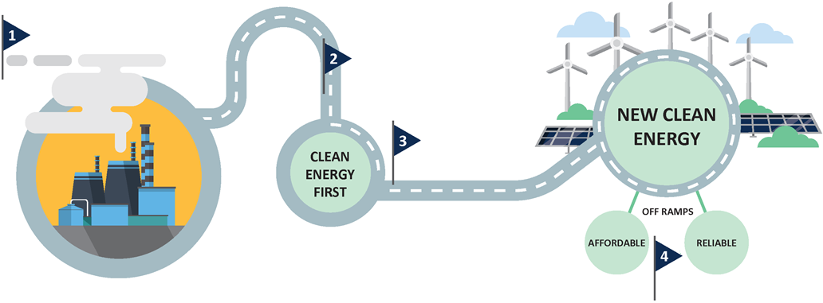
Clean Energy First
New Capacity Needed
Utility files plan
Look first to
clean energy
Test fit
Infographic source: CEE

Slide 8
Difference Between Existing Renewable Preference Statute & Clean Energy First
Current Renewable Preference Statute-216B.2422 Subd. 4
  Requires a utility to demonstrate that a renewable energy facility can not meet the needs of a proposed new or refurbished nonrenewable energy facility.
Proposed Clean Energy First (All current versions)
  Expands the preference statute to require a utility to demonstrate that a renewable energy facility alone or in combination with other clean energy resources cannot meet the proposed need.
Clean Energy First updates the preference statute to reflect a more innovative regulatory conversation about the role of clean energy resources

Slide 9
A Just Transition
Recognition that existing power plants employ hundreds of skilled community supporting jobs
Clean Energy First recognizes the community benefits of local hiring and jobs
We are committed to proactive engagement with communities affected by the transition

Slide 10
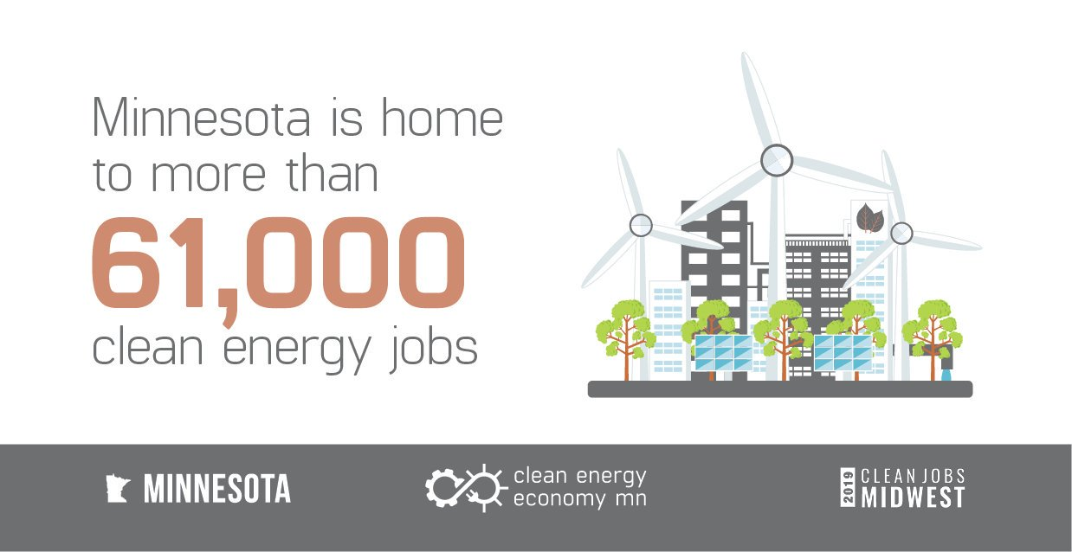
CLEAN ENERGY POWERS MN’S ECONOMY: the facts

Slide 11
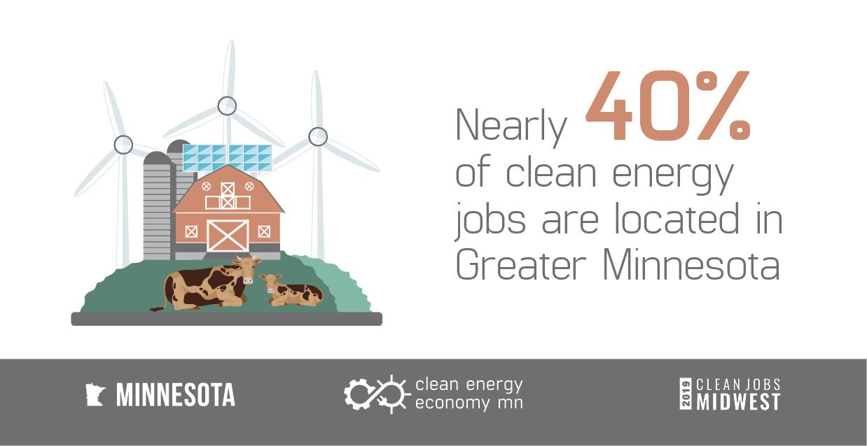
CLEAN ENERGY POWERS MN’S ECONOMY: the facts

Slide 12
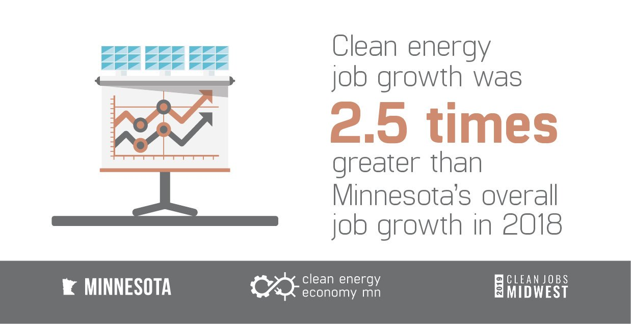
CLEAN ENERGY POWERS MN’S ECONOMY: the facts

Slide 13
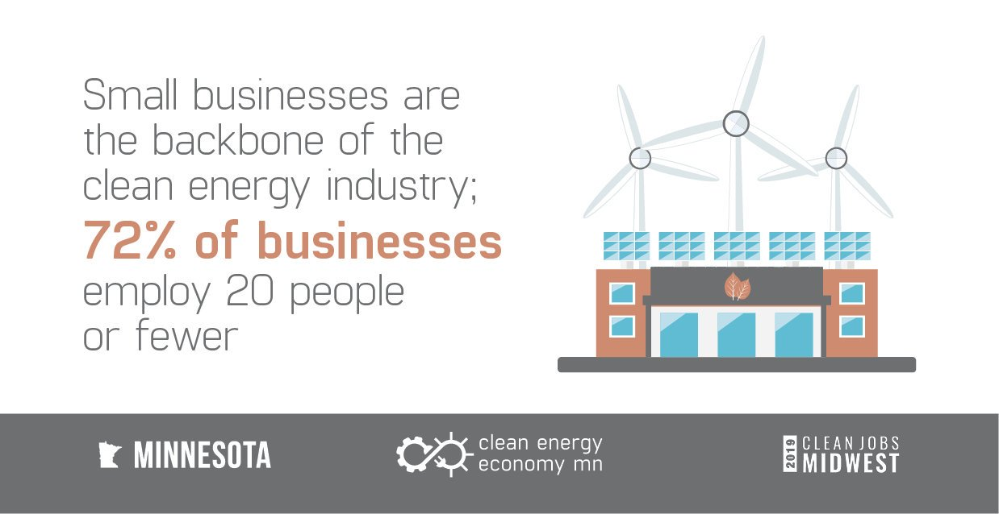
CLEAN ENERGY POWERS MN’S ECONOMY: the facts

Slide 14


CLEAN ENERGY POWERS MN’S ECONOMY: the stories

Slide 15
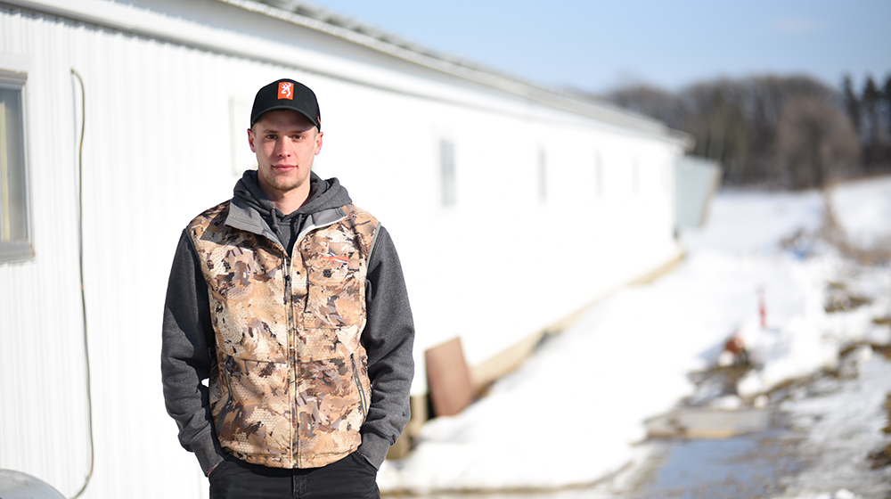
CLEAN ENERGY POWERS MN’S ECONOMY: the stories

Slide 16



CLEAN ENERGY POWERS MN’S ECONOMY: the stories

Slide 17
Thank You!
Steve Kelley, Commissioner
Steve.Kelley@state.mn.us

